Slide 1
Office of Animal Care Compliance (OACC)
HEALTH SCIENCES CENTER

Slide 2
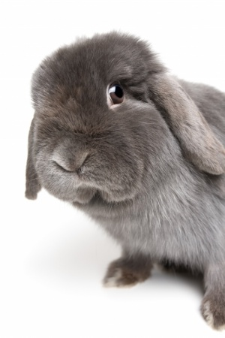
OACC Contact Info:
HEALTH SCIENCES CENTER
BRF G37 H & J
MSC08 4560
1 University of New Mexico
Albuquerque, NM 87131
Katy Mirowsky-Garcia, MS, CPIA Victoria Sugita, BS, LATg
kmirowsky@salud.unm.edu vsugita@salud.unm.edu
Senior Operations Manager Compliance Specialist
272-0418 272-6806

Slide 3
OACC
HEALTH SCIENCES CENTER
Main concern is compliance with all applicable state and federal mandates as well as UNM policies as they relate to animal welfare
Act as the liaison between PI’s and the regulators to facilitate compliant research
Maintain our assurances and registrations, submit annual reports, manage non-compliance, coordinate inspections and site visits, etc.

Slide 4
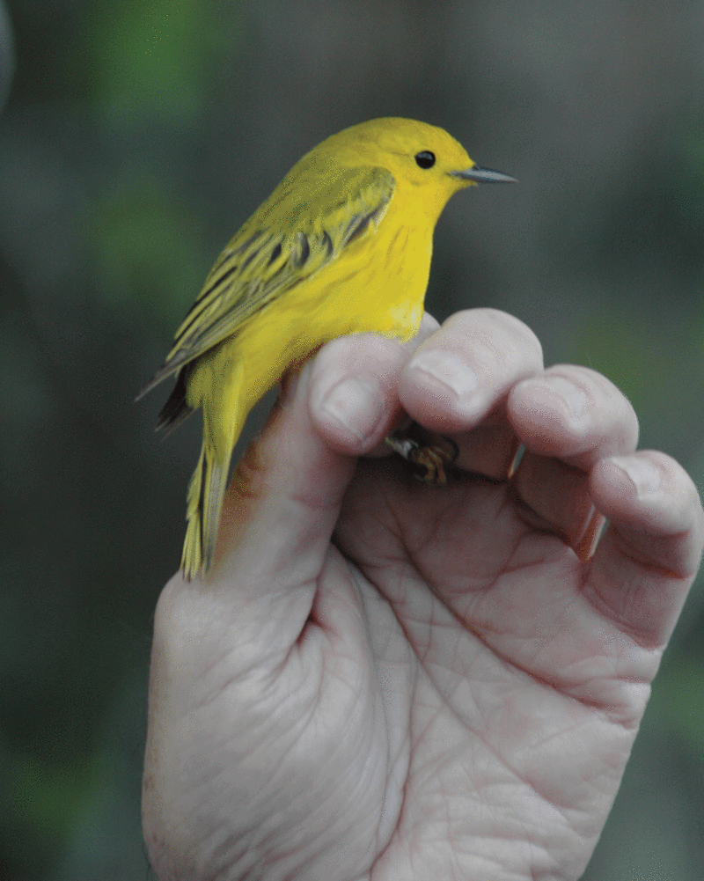
OACC (Cont’d)
HEALTH SCIENCES CENTER
Perform Post-Approval Monitoring (PAM)
Protocol review then a scheduled Q&A with the PI and/or other key lab personnel
Review of the personnel roster and all medical clearance and animal handling
training for personnel
Observation of approved procedures
and hands on techniques

Slide 5
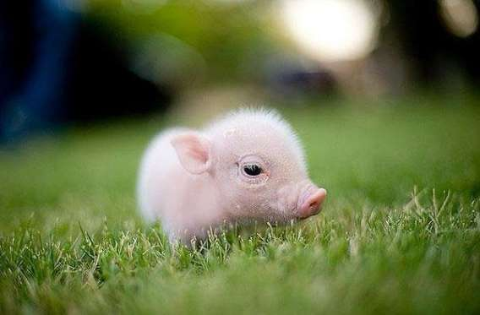
OACC (Cont’d)
HEALTH SCIENCES CENTER
Administrative arm of both Institutional Animal Care and Use Committees (IACUCs)
Coordinate all meetings and events
Manage all protocol submissions, reviews,
and approvals
Maintain all IACUC records

Slide 6
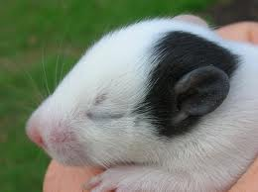
IACUC
HEALTH SCIENCES CENTER
Main concern is animal welfare.
HSC Campus and Main/Central Campus
Review and approve protocols (or withhold approval) for all activities involving animals
Inspect all animal research facilities/
study areas every 6 months and
review the animal program

Slide 7
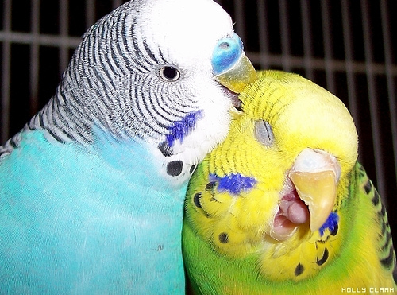
IACUC (cont’d)
HEALTH SCIENCES CENTER
Ensure that all personnel listed on an approved animal use protocol are qualified, trained, and medically cleared
Review/investigate all claims of non-compliance or misuse involving animals
Makes policies

Slide 8
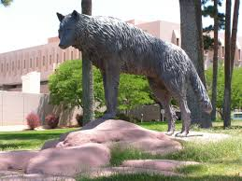
Institutional Official (IO)
HEALTH SCIENCES CENTER
Ensures institutional compliance and commits adequate resources to carry out the animal care and use program in accord with our assurances.
Signs all official documents, can suspend a protocol, appoints the IACUC and Chairs, etc.
President Frank is the MC IO

Slide 9
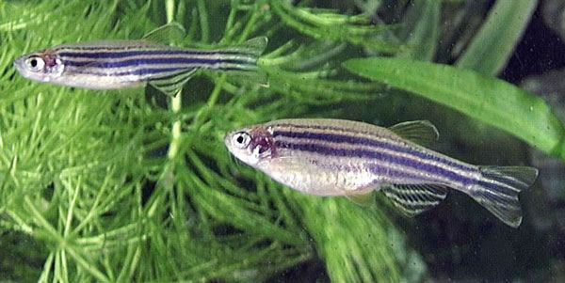
Researcher Responsibilities
All research, teaching, or testing involving vertebrate animals, their blood or tissues, must be carried out under an approved IACUC protocol.
All animal handlers must be medically cleared, properly trained, and listed on an approved animal care and use protocol.

Slide 10
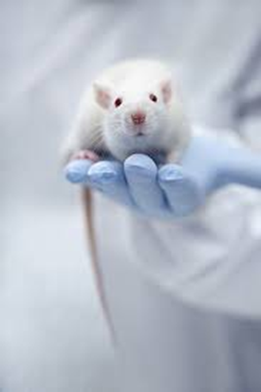
Researcher Responsibility (Con’t)
Animal handlers must be familiar with and follow the approved protocols without significant deviation and all changes must be approved through the IACUC.
Add/remove staff
Minor or major procedural changes
Addition of animals
Change in aims

Slide 11
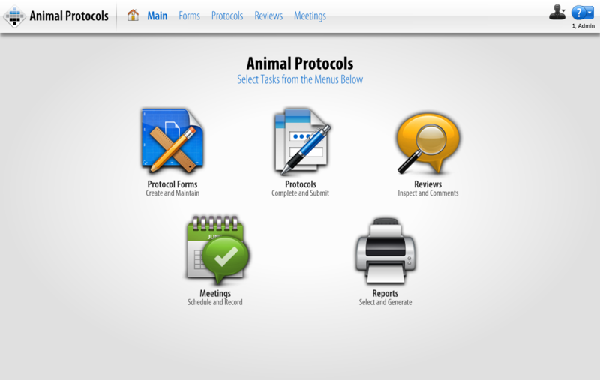
TOPAZ Elements
Research enterprise software used to manage animal protocols, orders, billing, and census campus wide

Slide 12
AALAS Learning Library (ALL)

Slide 13
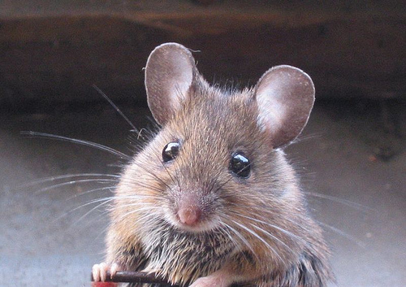
Ethical Conduct of Research:
HEALTH SCIENCES CENTER
Animal models should only be considered when there are no other alternative ways to achieve scientific goals that will further the good of mankind and other animals.
Animals, unlike human subjects, cannot consent themselves into studies so it is our ethical and moral imperative to follow the 3 R’s of animal research.

Slide 14
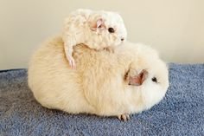
The 3 Rs (Russell and Burch, 1959):
HEALTH SCIENCES CENTER
Replace – Search for non-animal models
Reduce – Search for ways to use the least number of animals to accomplish your research goals while maintaining statistical significance
Refine – Search for alternatives to painful or distressful procedures
Visit the Animal Welfare Information Center (AWIC) for more information or to search:
http://awic.nal.usda.gov/alternatives

Slide 15
Why do we care if we’re in compliance?
HEALTH SCIENCES CENTER
Because it’s the right thing to do!
Because we receive federal funding to conduct research, we must follow the various federal regulations
We follow “The Guide” by NIH
(first published in 1963)

Slide 16
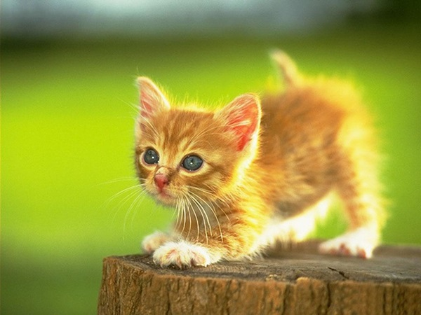
Compliance (cont’d)
HEALTH SCIENCES CENTER
Office of Laboratory Animal Welfare (OLAW)
Part of the Public Health Service (PHS)
Regulates all research facilities that obtain funding from The National Institutes of Health (NIH) and now the National Science Foundation (NSF)
Assurance “license” and number – D16-00565 (A4023-01)
Annual report

Slide 17
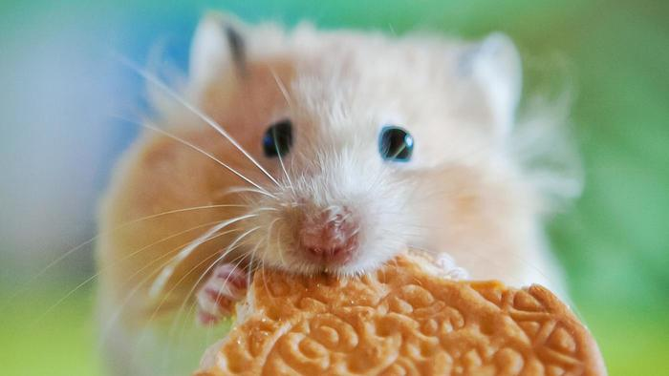
Compliance (Cont’d)
HEALTH SCIENCES CENTER
Because we’re mandated by the United States Department of Agriculture (USDA):
Performs unannounced inspection of facilities and animal records
Only inspects covered species such as:
Dogs, Cats, Rabbits, Hamsters (but not rats or mice)
Assurance “license” and registration
number 85-R-0002
Annual report

Slide 18
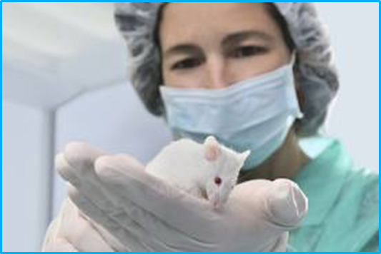
Voluntarily Accredited
HEALTH SCIENCES CENTER
Association for Assessment and Accreditation of Laboratory Animal Care (AAALAC)
HSC campus is fully accredited
All vertebrate animals are regulated
A site visit and program review every three years
Annual report

Slide 19
OACC Webpage: http://hsc.unm.edu/som/research/acc/

Slide 20
Assurance #s on Approval Letters

Slide 21
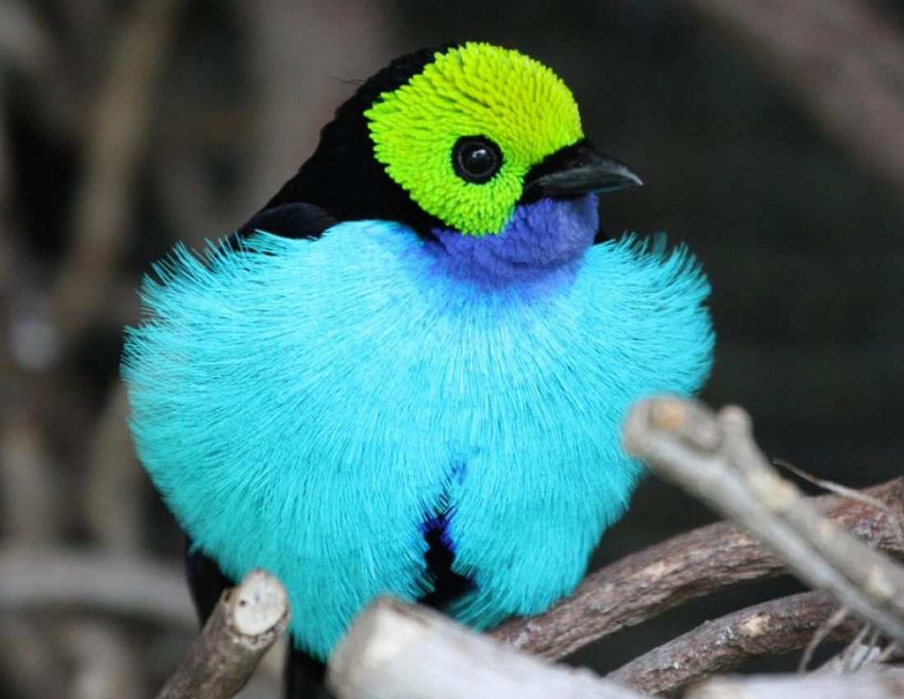
Grant Congruency
PIs are asked to attach the relevant vertebrate animal portions of their PHS (NIH or NSF) funded grants to the animal protocol form in TOPAZ
A grant to protocol congruency review is performed by the OACC for PHS projects
Projects that are funded after approval of IACUC protocols should have the grant information
updated in TOPAZ

Slide 22
The End – Questions?
HEALTH SCIENCES CENTER

